Slide 1
Listen to maps
René Rubalcava
SoftWhere Dev @ esri
@odoenet
HalfStack NY, Aug 2019

Slide 2
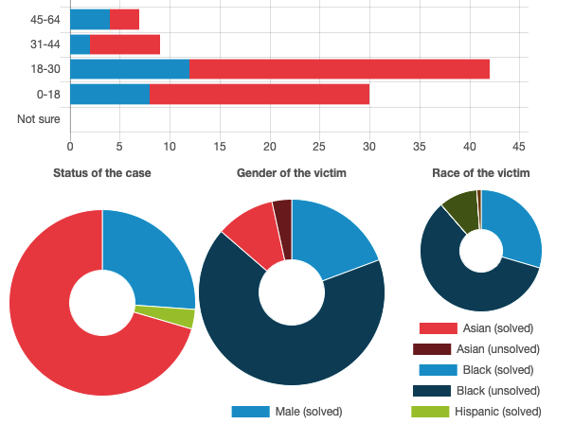
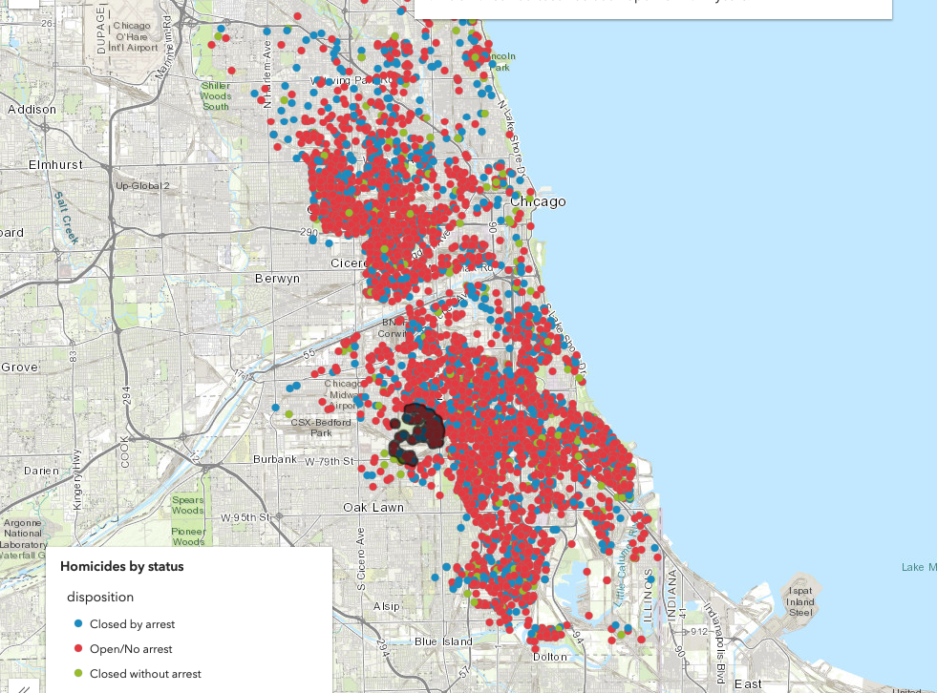
Insight
Maps to visualize data
Beyond points on map
Analysis tool
https://developers.arcgis.com/javascript/latest/sample-code/featurelayerview-query-distance/live/index.html

Slide 3
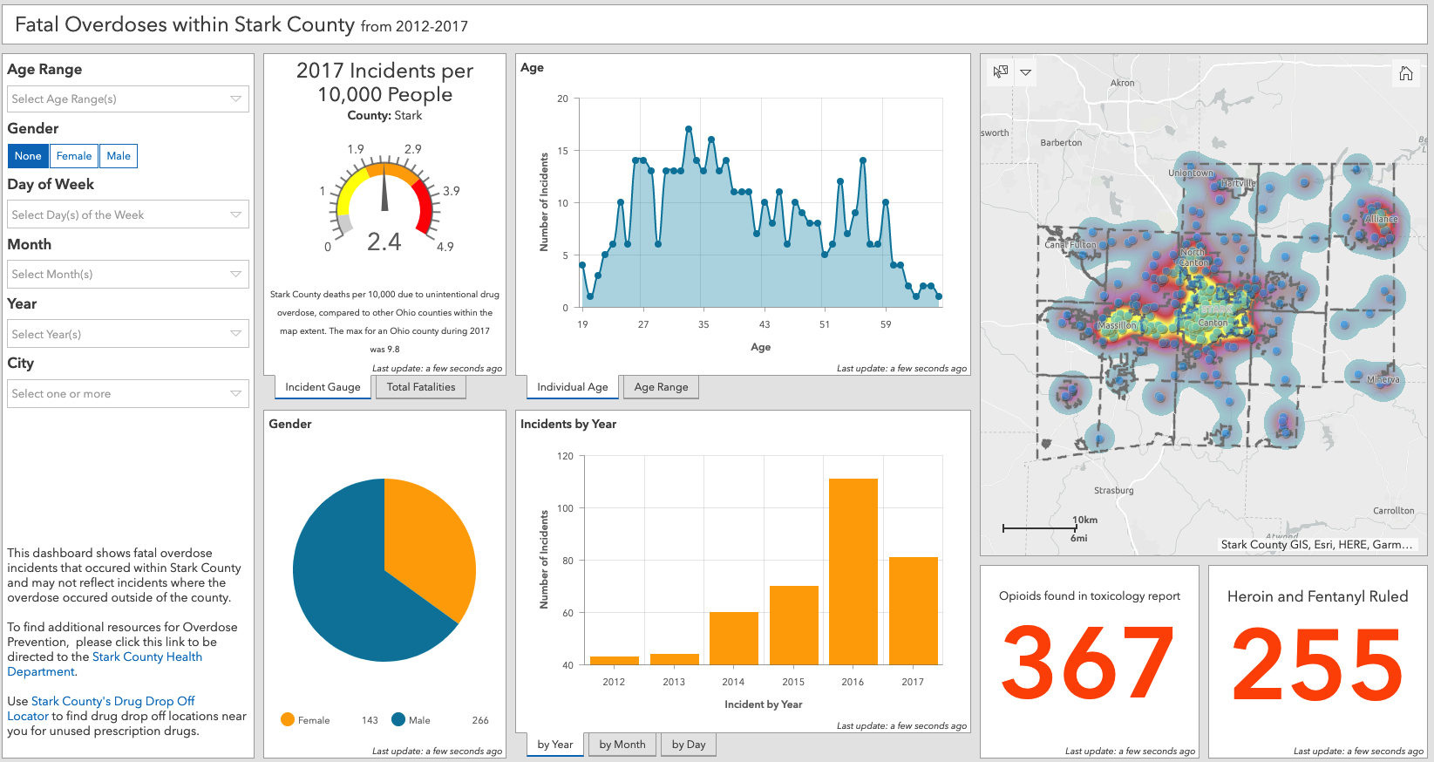
Data reporting
https://starkcountyohio.maps.arcgis.com/apps/opsdashboard/index.html#/568a71ea5f5845dfb8b135dbe5d46534

Slide 4
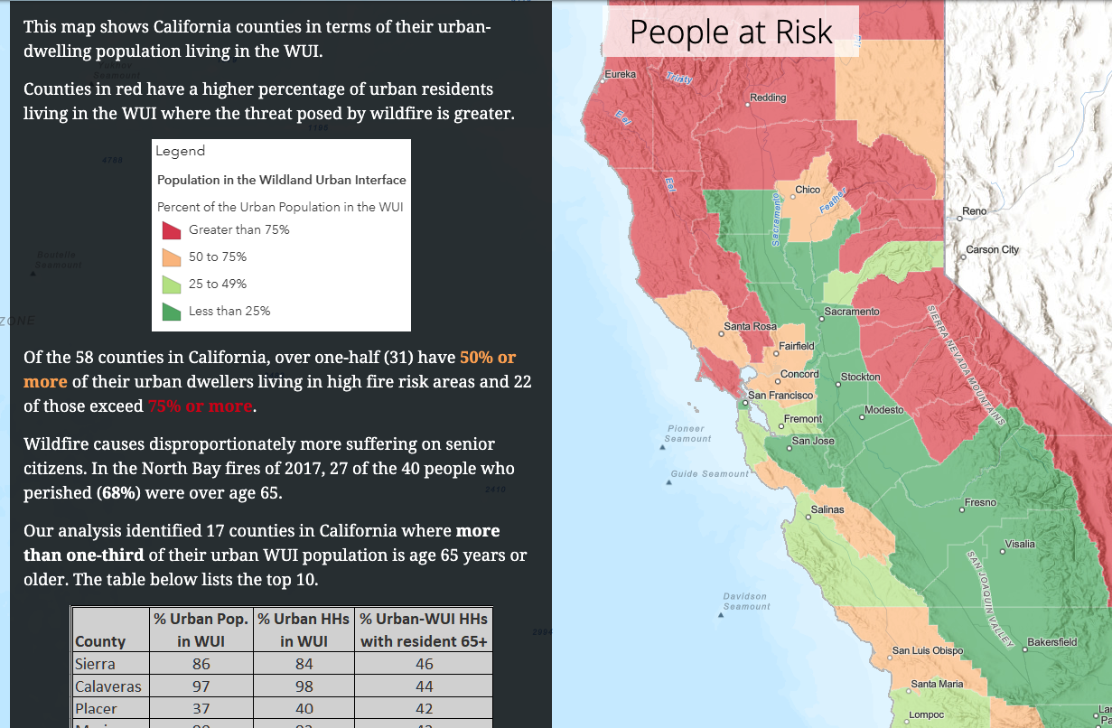
Story telling
Maps can tell a story
Data driven
A new look at the world
https://landscapeteam.maps.arcgis.com/apps/Cascade/index.html?appid=cd69320c00384d8094d83b45e84fd5aa

Slide 5
Can you hear me now?
Web Audio API - https://developer.mozilla.org/en-US/docs/Web/API/Web_Audio_API
Questions to ask
How can I listen to the story of a map?
Can I even do this?
Why would I do this?
What was I thinking?

Slide 6
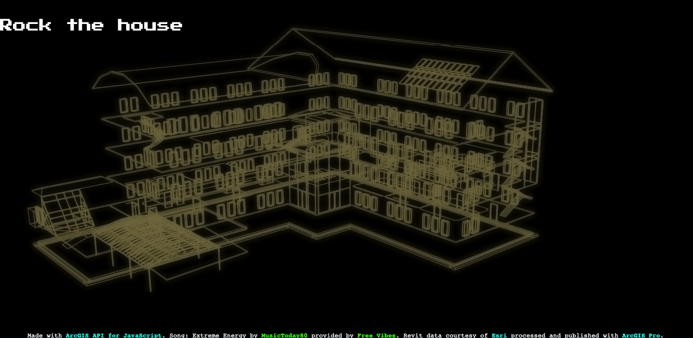
Rock the house
https://ralucanicola.github.io/JSAPI_demos/rock-the-house/

Slide 7
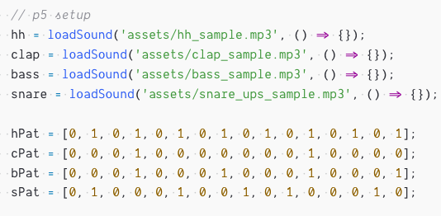
I’m lazy
p5.js
https://p5js.org/
Processing library with an audio module
ArcGIS API for JavaScript
https://js.arcgis.com
Mapping Library (I work on this team!)

Slide 8
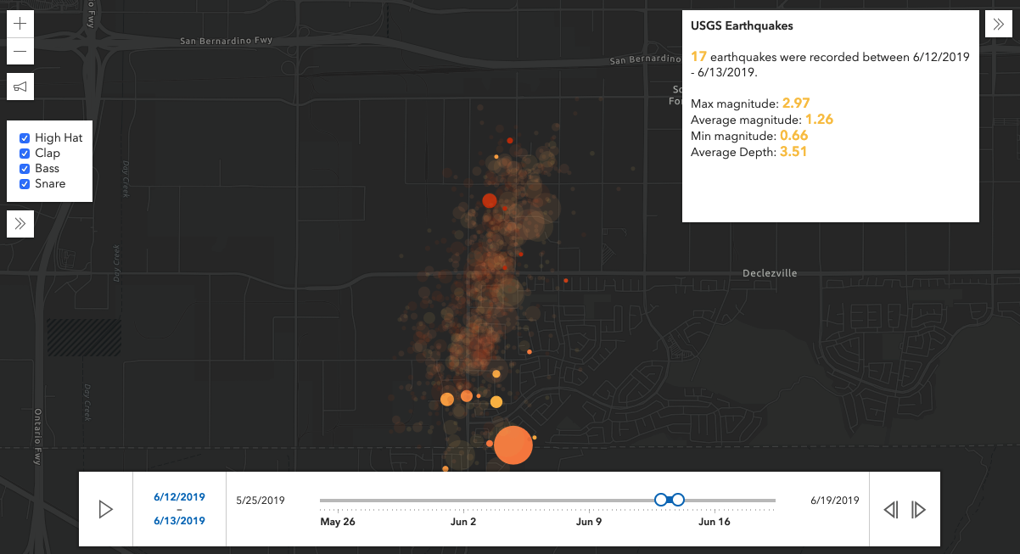
Earthquake time
Earthquakes in area over a period of time
Look at data in time slices
Statistics of data drive audio
Delay – echo effect driven by stats
BPM – beats per minute driven by count
https://odoe.github.io/listen-to-maps/time.html

Slide 9
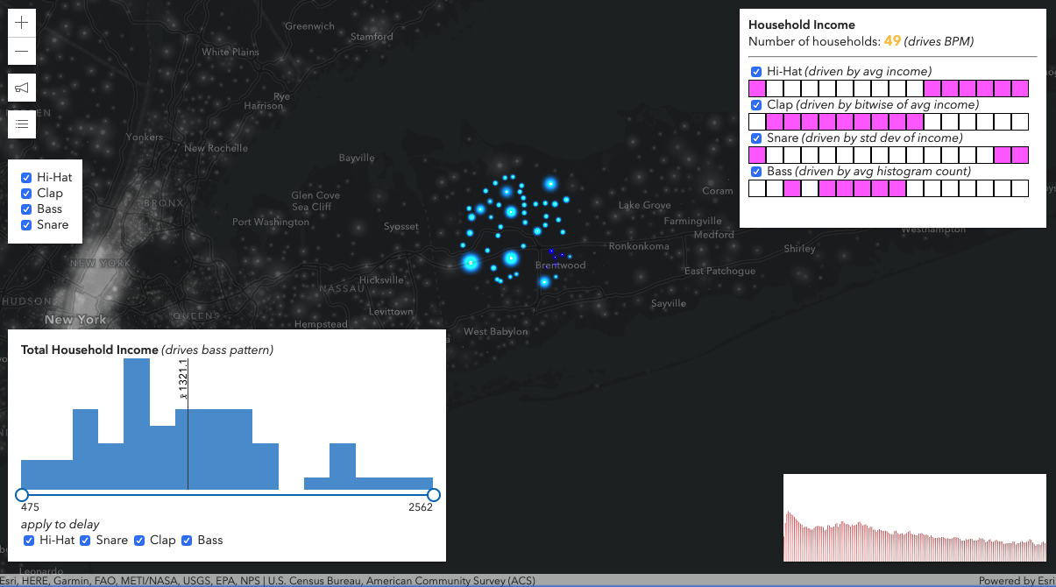
Voice of income
Update patterns
Above or below the average
16 fields to 16 steps in a sequence
Avg Value of field:
Below = 0
Above = 1
[0,0,0,1,0,0,0,1,0,0,0,1,0,0,0,1]
https://odoe.github.io/listen-to-maps/stats.html

Slide 10
Thank you

